Slide 1

Digital Portfolio
STUDENT NAME:G.jayasree
REGISTER NO AND NMID: asumn1112401111033012
DEPARTMENT: BCA/COMPUTER APPLICATION
COLLEGE: L N GOVERNMENT COLLEGE/MADRAS UNIVERSITY

Slide 2
PROJECT TITLE:
Project Title:
Smart Waste Management System using IoT & Machine Learning (Replace with your actual project title)
Smart Waste Management System using IoT
Project Title: Smart Waste Management System using IoT & Machine Learning (Replace with your actual project title)

Slide 3


Agenda:
Agenda Problem Statement Project Overview End Users Tools & Technologies Portfolio Design & Layout Features & Functionality Results & Screenshots Conclusion GitHub
3/21/2024 Annual Review

Slide 4

PROBLEM STATEMENT:
Problem Statement Urban areas face challenges in waste collection efficiency. Traditional methods lead to overflowing bins, unhygienic conditions, and higher costs. Lack of real-time monitoring creates inefficiencies in resource management.

Slide 5

PROJECT OVERVIEW:
Developed a smart solution to monitor and manage waste bins using IoT sensors. Integrated real-time data visualization and machine learning algorithms for predictive analysis. Provides alerts and optimized routes for collection teams.

Slide 6

WHO ARE THE END USERS?
Municipal Corporations – for smart city waste management. Waste Collection Companies – to optimize operations. General Public – cleaner surroundings and better hygiene.

Slide 7

TOOLS AND TECHNIQUES:
TOOLS AND TECHNIQUES:
Programming Languages: Python, JavaScript Frameworks: Flask, React.js Database: MySQL / MongoDB IoT Devices: Ultrasonic sensors, Arduino/ESP32 Version Control: Git & GitHub
TOOLS AND TECHNIQUES

Slide 8
POTFOLIO DESIGN AND LAYOUT:
Clean, minimalist UI with a focus on usability. Responsive dashboard for desktop & mobile. Used data visualization charts for real-time insights. Color scheme: Green (sustainability) + Blue (technology).
8
Programming Languages: Python, JavaScript Frameworks: Flask, React.js Database: MySQL / MongoDB IoT Devices: Ultrasonic sensors, Arduino/ESP32 Version Control: Git & GitHub

Slide 9
FEATURES AND FUNCTIONALITY:
Features & Functionality Real-time bin status monitoring Predictive waste level alerts using ML Automated notifications to collection teams Route optimization for efficiency Data dashboard with analytics & reports

Slide 10
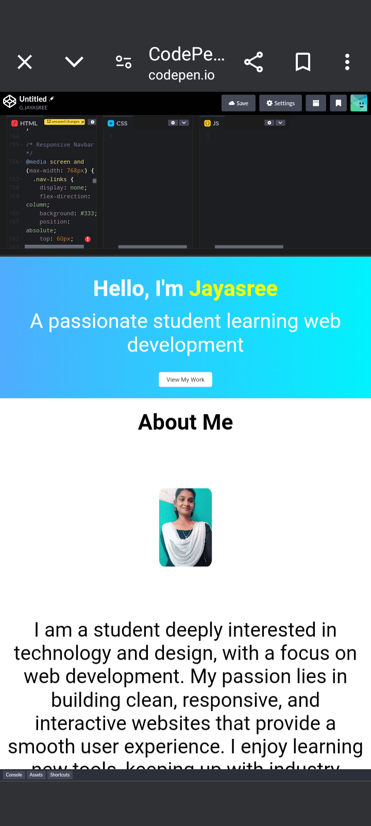

RESULTS AND SCREENSHOTS:
Reduced collection costs by 30% (simulation results).
Improved waste collection efficiency by 40%.
Sample screenshots of dashboard, alerts, and reports.
3/21/2024 Annual Review
10

Slide 11
GITHUB LINK:
https://bca2401111033012-source.github.io/My-profile2/
https://github.com/yourusername/yourproject ✨ Now, if you share: Your actual project title A short description of what your project does The technologies you used …I’ll personalize all slides with your details so your portfolio is presentation-ready.

Slide 12
CONCLUSION:
Conclusion The project demonstrates how IoT + AI can transform waste management. Provides a scalable, sustainable, and cost-effective solution. Future scope: integration with smart city platforms & AI-based route prediction
12

Slide 13


